Slide 1
UPPER SIXTH ARTS
GEOGRAPHY
Lesson 13
Recent Developments in Global Trade
Notes:
Good morning, class, and welcome to our geography lesson. I am your geography teacher, Mr Kamdem. Today we are starting Lesson 13: Recent Developments in Global Trade.

Slide 2
CLASS INFO
Class, Chapter and Duration
Class | Upper Sixth Arts
Chapter | Module 7: Understanding and managing contemporary environmental and development issues
Duration | 2 periods (2 × 50 minutes)
Notes:
This lesson is for Upper Sixth Arts. It belongs to Module 7: Understanding and managing contemporary environmental and development issues. We shall need 2 periods to cover it.

Slide 3
IDENTIFICATION
Lesson Identification
Topic | Current Development Issues
Sub-topic | Trade and Cooperation
Lesson | Lesson 13: Recent Developments in Global Trade
Notions / Concepts | Terms of trade, fair trade, WTO, Economic Partnership Agreement (EPA), protectionism.
Syllabus focus | Terms of trade; fair trade and efforts to ensure it; the World Trade Organization (creation and role); Economic Partnership Agreements.
Competence | Learners are able to explain terms of trade, fair trade, the WTO and EPAs.
Notes:
Our topic is Current Development Issues, and the sub-topic is Trade and Cooperation. The key notions we shall use today are: terms of trade, fair trade, WTO, Economic Partnership Agreement (EPA), protectionism. At the end, you should be able to do this: learners are able to explain terms of trade, fair trade, the WTO and EPAs.

Slide 4

HOMEWORK CORRECTION
Correction of the Homework
Question (Lesson 12: Trade Associations (Trade Blocs)):
Find out which goods Cameroon sells to Chad and Gabon.
Notes:
Before we start the new lesson, let us correct the homework I gave you at the end of Lesson 12: Trade Associations (Trade Blocs). The question was: Find out which goods Cameroon sells to Chad and Gabon. Take out your exercise books.

Slide 5
HOMEWORK CORRECTION
Correction: Possible Answer
Cameroon sells Chad and Gabon manufactured and food goods: cement, soap, beer and soft drinks, sugar, vegetable oil, plantains, onions and cattle products.
Notes:
Here is a good answer. Cameroon sells Chad and Gabon manufactured and food goods: cement, soap, beer and soft drinks, sugar, vegetable oil, plantains, onions and cattle products. Compare it with your own answer and correct your work in red.

Slide 6
LESSON PLAN
Lesson Plan
Correction of the homework
Objectives and recall
Real-life situation and action to take
Learning activities
Board summary
Evaluation, remediation and homework
Notes:
Here is the plan of our lesson today. First, we shall correct the homework. Then we shall look at the objectives and recall what you already know. After that, we shall study a situation from real life and the action to take, and do the learning activities. Finally, we shall copy the board summary, do the evaluation and the remediation, and I will give you the homework.

Slide 7
OBJECTIVES
Objectives
By the end of this lesson, you should be able to:
Explain the terms of trade.
Describe fair trade and its benefits.
Explain the role of the WTO and of EPAs.
Notes:
By the end of this lesson, you should be able to do three things. Number 1: explain the terms of trade. Number 2: describe fair trade and its benefits. Number 3: explain the role of the WTO and of EPAs.

Slide 8
PREVIOUS KNOWLEDGE
Previous Knowledge
Cameroon exports raw materials.
Manufactured goods are expensive.
Notes:
Let us first remember what you already know. Cameroon exports raw materials. Manufactured goods are expensive. Keep this in mind, because we shall build on it today.

Slide 9
REAL-LIFE SITUATION
Situation in Real Life
A cocoa farmer in Bokito says that each year he needs more bags of cocoa to buy the same motorbike. A fair trade cooperative offers him a better and stable price.
Notes:
Listen carefully to this situation from real life. A cocoa farmer in Bokito says that each year he needs more bags of cocoa to buy the same motorbike. A fair trade cooperative offers him a better and stable price. Think about it, because I am going to ask you some questions.

Slide 10
REAL-LIFE SITUATION
Situation: Question 1
What is the problem in the situation?
Notes:
Question 1: What is the problem in the situation? Think for a moment, then raise your hand to answer.

Slide 11
REAL-LIFE SITUATION
Answer
The farmer's terms of trade are getting worse.
Notes:
Good. The farmer's terms of trade are getting worse.

Slide 12
REAL-LIFE SITUATION
Situation: Question 2
What does the cooperative offer?
Notes:
Question 2: What does the cooperative offer? Think for a moment, then raise your hand to answer.

Slide 13
REAL-LIFE SITUATION
Answer
Fair trade: a better, stable price.
Notes:
Good. Fair trade: a better, stable price.

Slide 14
REAL-LIFE SITUATION
Situation: Question 3
Which organisation sets world trade rules?
Notes:
Question 3: Which organisation sets world trade rules? Think for a moment, then raise your hand to answer.

Slide 15
REAL-LIFE SITUATION
Possible Answer
The World Trade Organization (WTO).
Notes:
Good. The World Trade Organization (WTO).

Slide 16
ACTION TO TAKE
Action to Take
Buy fair-trade products and join cooperatives to get better prices.
Notes:
From this situation, the action we are working towards in this lesson is the following: buy fair-trade products and join cooperatives to get better prices.

Slide 17
JUSTIFICATION
Justification of the Lesson
This lesson helps us to understand how trade can become fairer.
Notes:
Why is this lesson important for you? This lesson helps us to understand how trade can become fairer.

Slide 18
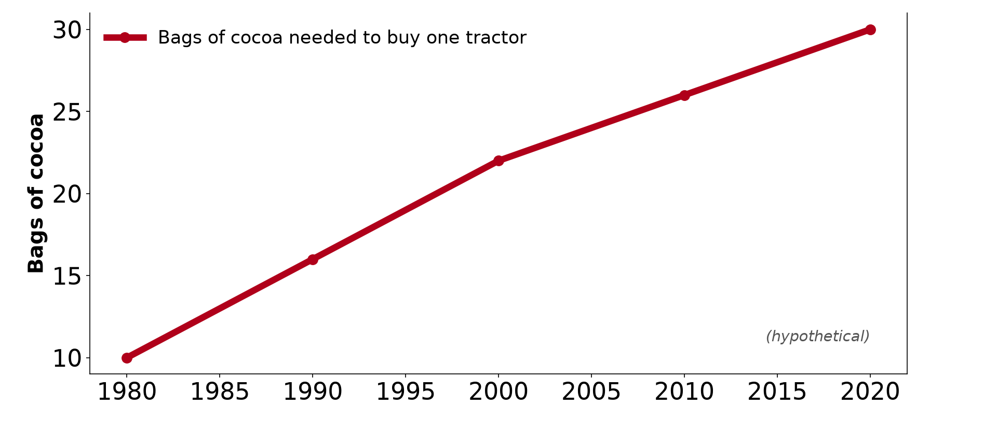
1. TERMS OF TRADE
Activity 1
Worsening terms of trade (hypothetical).
Notes:
Activity 1. Look carefully at this diagram: worsening terms of trade (hypothetical). Observe every detail before I ask the question.

Slide 19
1. TERMS OF TRADE
Activity 1: Question
What does the graph show?
Notes:
Here is the question for Activity 1: What does the graph show? Take one minute to think and write your answer in your rough notebook.

Slide 20
1. TERMS OF TRADE
Activity 1: Answer
More cocoa is needed to buy one tractor: the terms of trade are worsening.
Notes:
Let us check the answer together. More cocoa is needed to buy one tractor: the terms of trade are worsening.

Slide 21
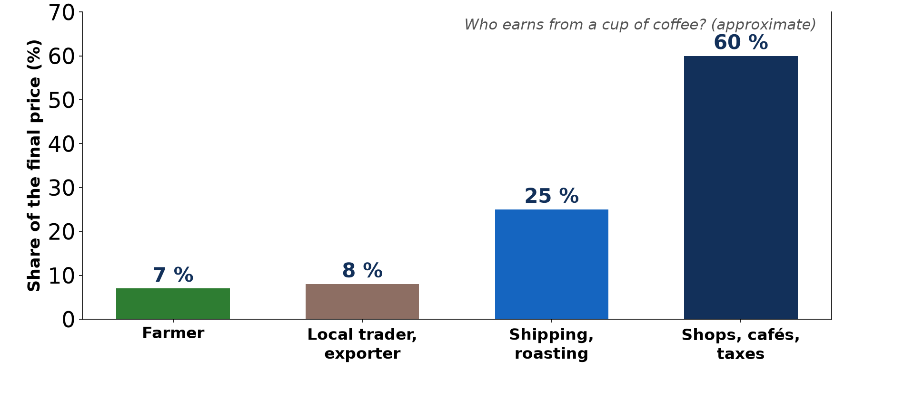
2. FAIR TRADE
Activity 2
Who earns from a cup of coffee (approximate).
Notes:
Activity 2. Look carefully at this diagram: who earns from a cup of coffee (approximate). Observe every detail before I ask the question.

Slide 22
2. FAIR TRADE
Activity 2: Question
Why is fair trade needed?
Notes:
Here is the question for Activity 2: Why is fair trade needed? Take one minute to think and write your answer in your rough notebook.

Slide 23
2. FAIR TRADE
Activity 2: Answer
Farmers get only a small share of the final price.
Notes:
Let us check the answer together. Farmers get only a small share of the final price.

Slide 24
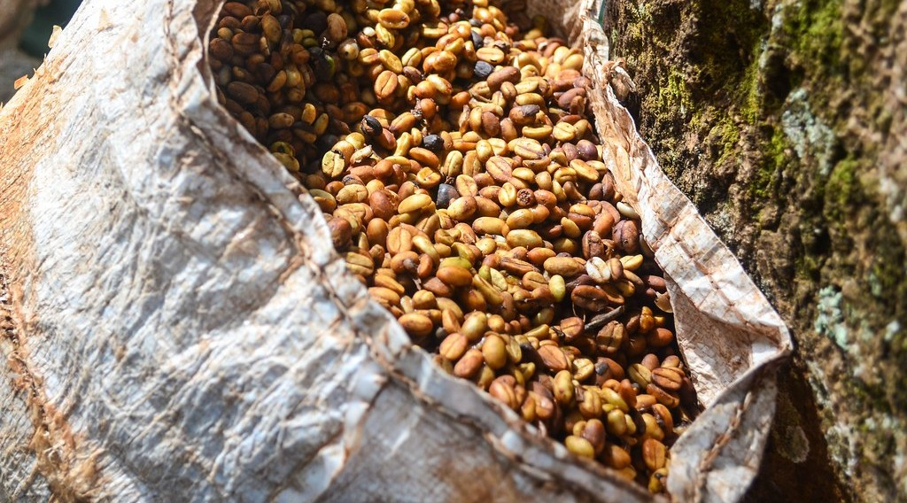
2. FAIR TRADE
Activity 3
Coffee beans harvested in Cameroon.
Notes:
Activity 3. Look carefully at this picture: coffee beans harvested in Cameroon. Observe every detail before I ask the question.

Slide 25
2. FAIR TRADE
Activity 3: Question
Give two benefits of fair trade for farmers.
Notes:
Here is the question for Activity 3: Give two benefits of fair trade for farmers. Take one minute to think and write your answer in your rough notebook.

Slide 26
2. FAIR TRADE
Activity 3: Answer
A minimum price and a premium for schools and clinics.
Notes:
Let us check the answer together. A minimum price and a premium for schools and clinics.

Slide 27
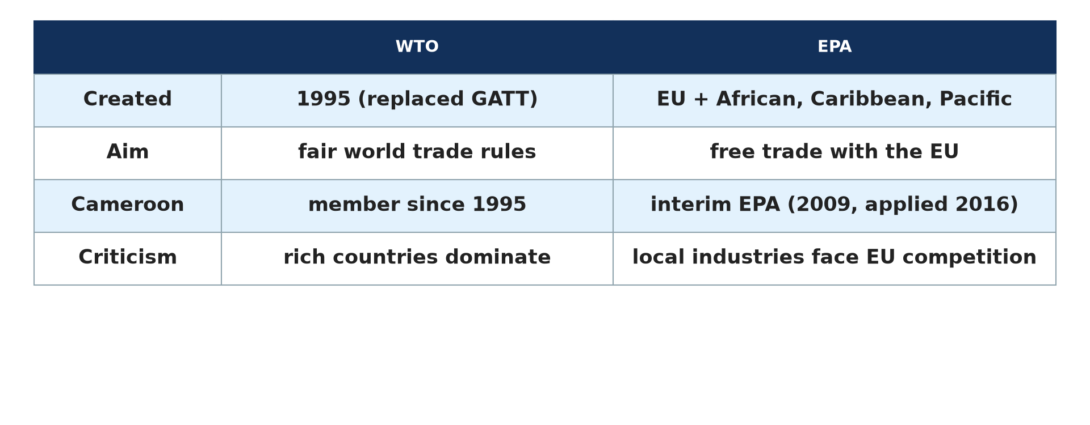
3. THE WTO
Activity 4
WTO and EPA.
Notes:
Activity 4. Look carefully at this diagram: wTO and EPA. Observe every detail before I ask the question.

Slide 28
3. THE WTO
Activity 4: Question
Give two roles of the WTO.
Notes:
Here is the question for Activity 4: Give two roles of the WTO. Take one minute to think and write your answer in your rough notebook.

Slide 29
3. THE WTO
Activity 4: Answer
It makes trade rules and settles trade disputes.
Notes:
Let us check the answer together. It makes trade rules and settles trade disputes.

Slide 30

4. EPAs
Activity 5
Goods traded with Europe.
Notes:
Activity 5. Look carefully at this picture: goods traded with Europe. Observe every detail before I ask the question.

Slide 31
4. EPAs
Activity 5: Question
Give one advantage and one risk of the EPA for Cameroon.
Notes:
Here is the question for Activity 5: Give one advantage and one risk of the EPA for Cameroon. Take one minute to think and write your answer in your rough notebook.

Slide 32
4. EPAs
Activity 5: Answer
Advantage: free access to the EU market. Risk: local industries face EU competition.
Notes:
Let us check the answer together. Advantage: free access to the EU market. Risk: local industries face EU competition.

Slide 33
BOARD SUMMARY
Board Summary
Topic: Current Development Issues
Sub-topic: Trade and Cooperation
Lesson 13: Recent Developments in Global Trade
Notes:
Now we are going to copy the board summary. Write the title and the headings neatly in your notebooks. I will give you enough time for each slide, so do not rush.

Slide 34
BOARD SUMMARY
1. Terms of Trade
Terms of trade can be explained as follows:
Terms of trade: It is the value of a country's exports compared with its imports. They worsen when export prices fall while import prices rise.
Notes:
Let us copy Terms of Trade. Terms of trade can be explained as follows. On this slide we have Terms of trade. Write each point on a new line, with the key term first, and explain it in your own words when we revise. When you finish, we go to the next slide.

Slide 35
BOARD SUMMARY
1. Terms of Trade (continued)
Trend for LEDCs: Prices of raw materials rise slowly or fall, while manufactured goods become dearer. LEDCs must export more to buy the same imports.
Notes:
We continue with Terms of Trade. On this slide we have Trend for LEDCs. Write each point on a new line, with the key term first, and explain it in your own words when we revise.

Slide 36
BOARD SUMMARY
1. Terms of Trade
Illustration: worsening terms of trade (hypothetical)
Notes:
Now draw this illustration in your notebook: worsening terms of trade (hypothetical). Give it a title and label it clearly.

Slide 37
BOARD SUMMARY
2. Fair Trade
Fair trade can be explained as follows:
Meaning: Fair trade is trade that pays producers a fair and stable price. It also pays a premium for community projects.
Notes:
Let us copy Fair Trade. Fair trade can be explained as follows. On this slide we have Meaning. Write each point on a new line, with the key term first, and explain it in your own words when we revise. When you finish, we go to the next slide.

Slide 38
BOARD SUMMARY
2. Fair Trade (continued)
Efforts to ensure it: Fair-trade labels, cooperatives and direct buying from farmers raise their share of the price. Consumers in rich countries pay more for these products.
Notes:
We continue with Fair Trade. On this slide we have Efforts to ensure it. Write each point on a new line, with the key term first, and explain it in your own words when we revise.

Slide 39
BOARD SUMMARY
2. Fair Trade
Illustration: who earns from a cup of coffee (approximate)
Notes:
Now draw this illustration in your notebook: who earns from a cup of coffee (approximate). Give it a title and label it clearly.

Slide 40
BOARD SUMMARY
3. The WTO and the EPAs
Recent developments in global trade include the following:
WTO: It was created in 1995 to replace GATT and has about 164 members. It sets rules, reduces tariffs and settles trade disputes.
Notes:
Let us copy The WTO and the EPAs. Recent developments in global trade include the following. On this slide we have WTO. Write each point on a new line, with the key term first, and explain it in your own words when we revise. When you finish, we go to the next slide.

Slide 41
BOARD SUMMARY
3. The WTO and the EPAs (continued)
EPAs: Economic Partnership Agreements are free trade deals between the EU and African, Caribbean and Pacific countries. Cameroon signed one in 2009, which opens European markets but exposes local industries to competition.
Notes:
We continue with The WTO and the EPAs. On this slide we have EPAs. Write each point on a new line, with the key term first, and explain it in your own words when we revise.

Slide 42
BOARD SUMMARY
3. The WTO and the EPAs
Illustration: WTO and EPA
Notes:
Now draw this illustration in your notebook: wTO and EPA. Give it a title and label it clearly.

Slide 43
FORMATIVE EVALUATION
Evaluation 1
Explain worsening terms of trade for Cameroon.
Notes:
Now let us check what you have understood. Question 1: Explain worsening terms of trade for Cameroon. Answer in your exercise book.

Slide 44
FORMATIVE EVALUATION
Expected Answer
Its export prices fall compared with the prices of its imports.
Notes:
The expected answer is: its export prices fall compared with the prices of its imports. If you got it right, well done.

Slide 45
FORMATIVE EVALUATION
Evaluation 2
Give two roles of the WTO.
Notes:
Now let us check what you have understood. Question 2: Give two roles of the WTO. Answer in your exercise book.

Slide 46
FORMATIVE EVALUATION
Expected Answer
Makes trade rules and settles disputes.
Notes:
The expected answer is: makes trade rules and settles disputes. If you got it right, well done.

Slide 47
REMEDIATION
Remediation
Fill in the blanks:
The WTO was created in ______.
The WTO replaced ______.
Trade with a guaranteed price is ______ trade.
Notes:
For those who need more practice, fill in the blanks in your exercise book. The answers are: number 1, 1995; number 2, GATT; number 3, fair.

Slide 48
HOMEWORK
Homework
Compare the price of a bag of cocoa and a bag of cement over five years.
Notes:
For your homework: Compare the price of a bag of cocoa and a bag of cement over five years. We shall correct it at the beginning of our next lesson.

Slide 49
NEXT LESSON
Next Lesson
Our next lesson will be on:
Lesson 14: Aid and Interdependence
Notes:
Our next lesson will be on Lesson 14: Aid and Interdependence. Thank you for your attention, and see you next time.

Slide 50
BILINGUAL GAME
Bilingual Game (Jeu Bilingue)
English | Français
Terms of trade | Les termes de l'échange
Fair trade | Le commerce équitable
Price | Le prix
Cooperative | La coopérative
Agreement | L'accord
Subsidy | La subvention
Notes:
Let us play the bilingual game. I say a word in English, and you give me the French word. Then we do the reverse.

Slide 51
LOGBOOK
Official Logbook (1/2)
Module / Topic | Current Development Issues
Lesson Title | Lesson 13: Recent Developments in Global Trade
Expected Learning Outcomes | Explain the terms of trade. Describe fair trade and its benefits. Explain the role of the WTO and of EPAs.
Competence | Learners are able to explain terms of trade, fair trade, the WTO and EPAs.
Notes:
I record this information in the official logbook of the class after the lesson.

Slide 52
LOGBOOK
Official Logbook (2/2)
Matter Taught | Terms of Trade; Fair Trade; The WTO and the EPAs.
Evaluation | Formative evaluation and remediation exercise.
Homework | Compare the price of a bag of cocoa and a bag of cement over five years.
Enrolment / Present / Absent | ____ / ____ / ____
Achievement | To be completed after the lesson.
Notes:
I complete the second page of the logbook: the matter taught, the evaluation, the homework and the attendance.

Slide 53
TEACHER'S NOTE
Teacher's Note
Timing: Homework correction, plan, objectives 8 min | Recall, situation, action 10 min | 5 activities 30 min | Board summary (copying) 30 min | Evaluation, remediation 10 min | Homework, next lesson 5 min | Logbook 7 min
Without the projector (Activity 1): read the line.
Without the projector (Activity 2): read the bars.
Without the projector (Activity 3): discuss cooperatives.
Without the projector (Activity 4): read the table.
Without the projector (Activity 5): debate the EPA.
Notes:
This slide is for me, the teacher: it gives the timing of the lesson and what to do if the projector is not available.

Slide 54
REFERENCES
References
National Geography Syllabus, MINESEC/IGE/IP-SS, 2019 — Module 7 (Environment and Development).
Photo, Activity 3: “Harvesting coffee, Cameroon” by jbdodane, CC BY-NC 2.0, via Flickr (https://www.flickr.com/photos/27998473@N02/11590251453)
Photo, Activity 5: “Container Ships @ Port of Oakland” by jdnx, CC BY 2.0, via Flickr (https://www.flickr.com/photos/21442511@N08/3464243881)
Diagrams and animations: drawn for this lesson (Geography Department).
Notes:
These are the references and picture credits used to prepare this lesson.

